Slide 1
Short-Term Reversal Strategy with Risk Adjustments
Rafael Dias de Souza
Fin 7053
Algorithmic Trading: Final Project

Slide 2
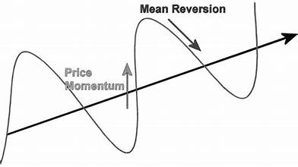
Financial markets are not perfectly efficient in the short run. Behavioral biases often lead investors to overreact to recent information, pushing prices away from their fundamental values. As a result: 1. Recent losers may become undervalued 2. Recent winners may become overvalued This creates an opportunity for a systematic strategy that: - Buys past losers - Sells past winners - Profits from mean reversion in prices
Strategy Overview

Slide 3
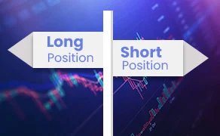
The trading signal is constructed using past returns: 1. For each stock, I compute the previous month’s return 2. Stocks are ranked cross-sectionally based on this metric 3. Portfolios are formed by grouping stocks into quantiles Portfolio construction: - Long position in the worst-performing stocks (losers) - Short position in the best-performing stocks (winners) To ensure realism: - All signals are lagged - Only information available at the time is used
Signal Construction

Slide 4
Implementation & Enhancements
Portfolio Construction
Long-short portfolio targeting short-term reversals
Monthly rebalancing to update signals
Equal-weighted to ensure diversification
Implementation Details
Equal weights across selected stocks
Monthly rebalancing → high turnover
Assume execution at closing prices
Trading Rules
Enter positions at the start of each month
Long losers (bottom decile), short winners (top decile)
Hold for one month, then rebalance
Risk Adjustments
Volatility Scaling
Adjusts exposure based on market volatility
Reduces risk in volatile periods
Regime Filter
Adjusts exposure based on market conditions
Limits downside during unfavorable periods

Slide 5
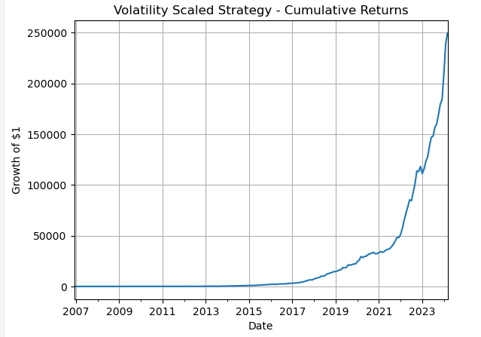
Volatility Scaling Performance
Volatility scaling adjusts the portfolio’s exposure based on recent market volatility. When volatility increases, the strategy reduces its exposure, and when volatility is low, it increases exposure.
This results in:
- A smoother return profile
- Reduced extreme fluctuations
- Improved risk-adjusted performance
- The Sharpe ratio increases significantly compared to the baseline strategy, indicating that risk control
- plays a critical role in performance enhancement.

Slide 6
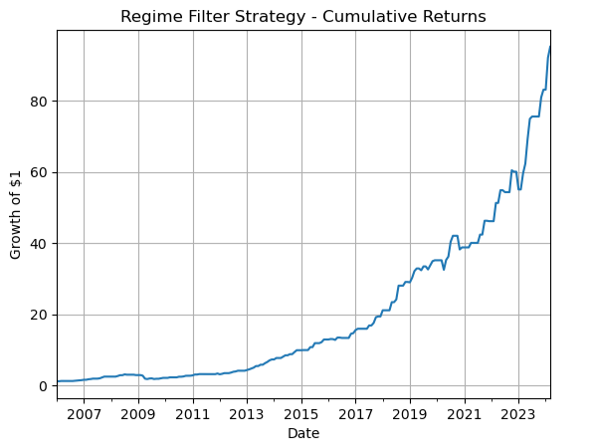
The regime filter attempts to improve performance by conditioning the strategy on broader market conditions. The idea is that: - Some market environments are more favorable for reversal strategies - Avoiding unfavorable periods can reduce losses However, results show that: - The Sharpe ratio is lower than the volatility-scaled strategy - Some profitable periods are excluded - The filter may be too restrictive
Regime-Based Strategy Performance

Slide 7
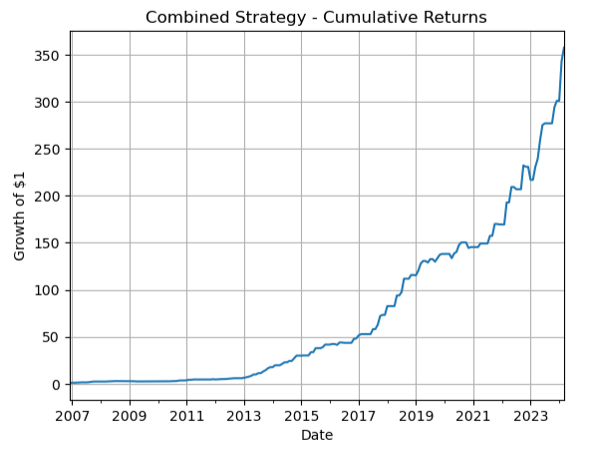
The combined strategy integrates both volatility scaling and regime filtering. This approach aims to: - Maintain stable exposure through volatility control - Avoid unfavorable market regimes Results show: - Improved stability compared to baseline - Better performance than regime filter alone - But slightly weaker than volatility scaling alone This suggests that combining multiple risk controls may lead to diminishing returns.
Combined Strategy Performance

Slide 8
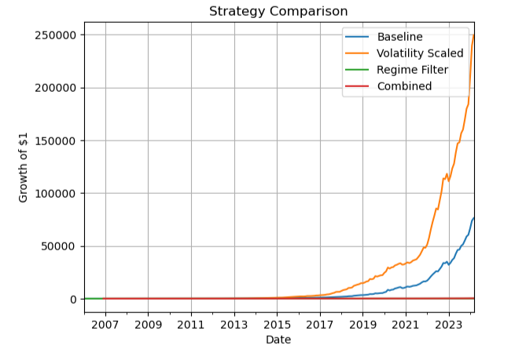
The baseline strategy confirms the presence of short-term reversal, generating strong returns but with higher volatility and less consistent performance.
Volatility scaling significantly improves the strategy by smoothing the return path and increasing the Sharpe ratio, showing that dynamic risk adjustment is highly effective.
The regime filter helps reduce downside risk by avoiding certain market conditions, but it also excludes profitable periods, leading to lower overall performance.
The combined strategy improves stability relative to the baseline and performs better than the regime filter alone, but it does not outperform volatility scaling, suggesting diminishing returns from added complexity.
Comparative Analysis

Slide 9
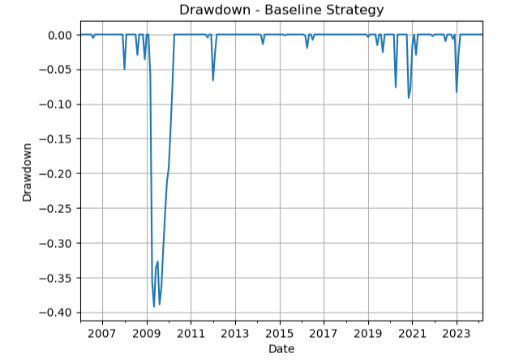
Transaction Costs & Market Impact - High turnover implies significant transaction costs - Bid-ask spreads and price impact may reduce returns - Strategy performance is likely overstated without cost adjustments Backtesting Biases - Look-ahead bias avoided using lagged signals - Survivorship bias may still be present depending on the dataset - Results may be sensitive to sample period
Risk Analysis

Slide 10
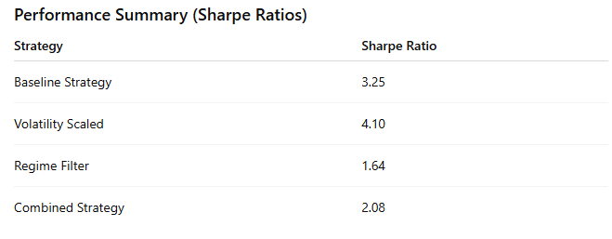
The strategy’s performance is evaluated across different time periods to ensure that results are not driven by a specific market environment. While performance varies over time, the core reversal effect remains present, suggesting the signal is reasonably robust.
However, like many quantitative strategies, results may still be sensitive to the sample period and specific parameter choices, meaning performance could differ under alternative assumptions.
In terms of implementation, the strategy involves frequent rebalancing and trading across many stocks, leading to high turnover.
This creates potential capacity constraints, as scaling the strategy to larger capital may become difficult due to liquidity limitations and increased market impact.
As position sizes grow, executing trades without affecting prices becomes more challenging, which could reduce realized returns.
Robustness & Capacity Analysis

Slide 11
The results confirm that short-term reversal is a persistent and exploitable signal, generating strong baseline performance
Risk management plays a critical role in improving the strategy, with volatility scaling significantly enhancing stability and risk-adjusted returns
Not all enhancements add value — while regime filtering reduces downside risk, it can also remove profitable opportunities and weaken performance
The combined strategy improves robustness, but does not outperform volatility scaling alone, highlighting diminishing returns from added complexity
Final Takeaways

